Slide 1
Warm-up 10/1/19
Write your “Today’s Work” in your planner
Then answer…
If your were the emperor of a nation in the middle ages how would you solve a rebellion?

Slide 2
Warm-up 10/2/19
Write “Today’s Work” in your planner and then answer the following question on your Warm-up sheet:
Do you think Justinian I handled the Nika(Blue and Green) Revolt well? Why or Why not? How would you have handled it?, review page 63 of text if needed

Slide 3
Warm- up 10/3/19
The Eastern Orthodox Church(check pg. 61 of text)
separated from the Roman Catholic Church.
supported the Holy Roman emperor.
dissolved after the Roman Empire fell.
2. After the riots of 532, who was responsible for rebuilding Constantinople?
A. Leo III, B. Justinian I, C. Constantine
3. What was the relationship between the Byzantine religion and government?
A. The emperor competed with the pope
B. Church and state were united
C. People practiced many religions.

Slide 4
Warm-up 10/4/19
What do you think are 2 of Justinian’s greatest achievements? Why?

Slide 5
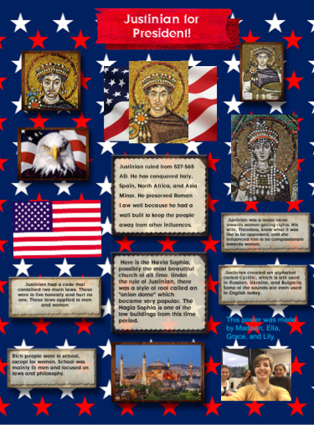

Slide 6
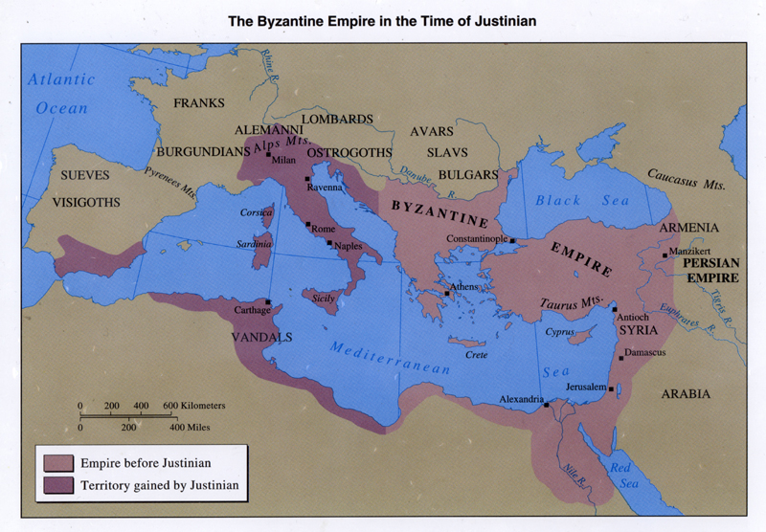
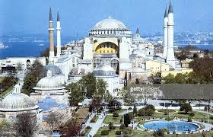
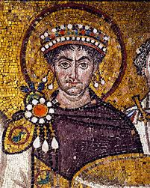
Warm-up 10/7/19
Do you think Justinian I would be a good president? Why or why not?

Slide 7
Warm-up 10/8/19
Do you think laws in America are just/fair? Why or why not? What changes would you make?

Slide 8
Warm-up 10/9/19
Use the glossary at the back of your textbook(you will need to get your textbook) to write the definition to these terms on your warm-up sheet:
monarch
fief
manor
noble

Slide 9
Warm-up 10/10/19
Describe what you think a leader should be like.

Slide 10
Warm-up 10/11/19
What did you learn about Charlemagne from your reading (Binder pg. 27-28)? Make a list of his traits.

Slide 11
Warm-up 10/14/19
What doe the word “loyalty” mean to you?

